Slide 1
Chapter 8 Advanced Counting Techniques
8.1 Recurrence Relations
8.2 Solving Linear Recurrence Relations
8.4 Generating Functions
8.5 Inclusion-Exclusion
8.6 Applications of Inclusion-Exclusion

Slide 2
8.4 Generating Functions
Generating functions are useful for manipulating sequences.
  It can be used to solve many kinds of counting problems, such as
    -- The problem of combination and permutation with constraints
    -- The number of ways to make change for a dollar using coins of different denominations
  Solve recurrence relations
  Prove the combinatorial identities

Slide 3

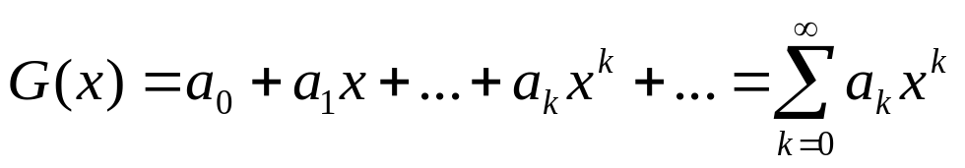
8.4 Generating Functions
1. Generating function for a sequence
【Definition 1】 The generating function for the sequence
of real numbers is the infinite series
A generating function is a clothesline on which we hang up a sequence of numbers for display.
  — Herbert Wilf, Generatingfunctionology (1994)

Slide 4
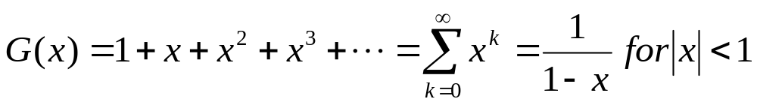
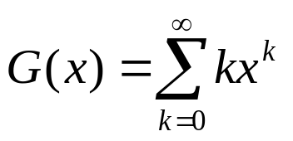
8.4 Generating Functions
〖Example 1〗
What is the generating function for the sequence
1, 1, 1, 1, ...?
(2) What is the generating function for the sequence 0, 1, 2, 3, 4, 5, ...?

Slide 5
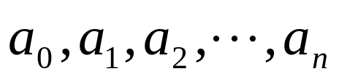

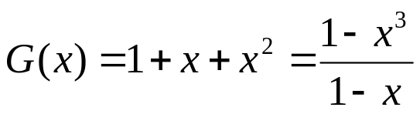

8.4 Generating Functions
The generating function for a finite sequence of real numbers
is
〖Example 2〗
The finite sequence: 1,1,1. The generating function for this sequence is
(2) Let . The generating function for this sequence is

Slide 6
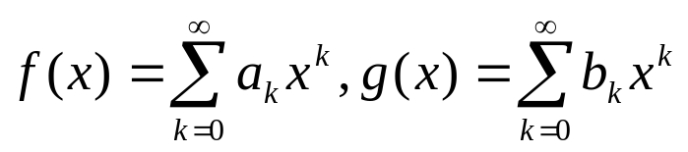
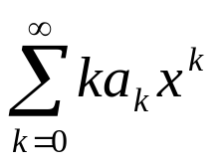
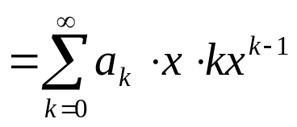
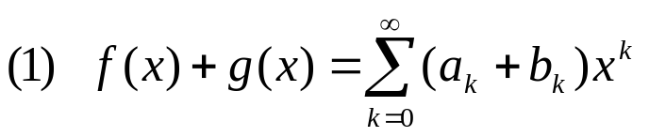
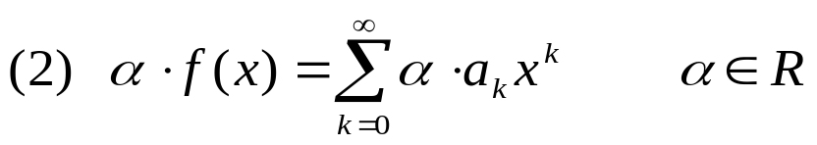
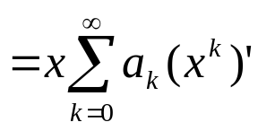
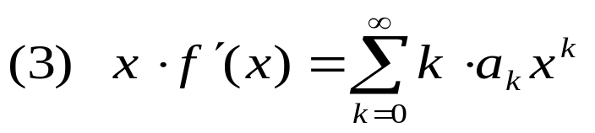
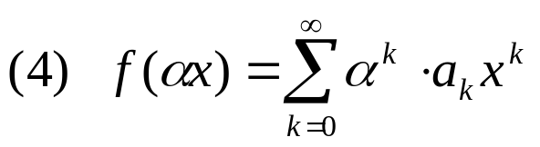
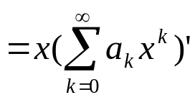
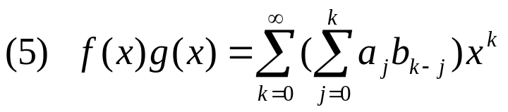

8.4 Generating Functions
2. Useful Facts About Power Series
【Theorem 1】Let . Then
Proof:

Slide 7
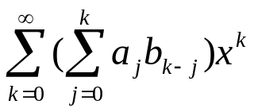
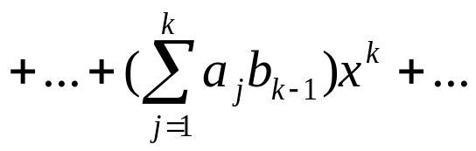

8.4 Generating Functions
2. Useful Facts About Power Series
Proof:
Let . Then

Slide 8
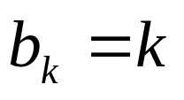
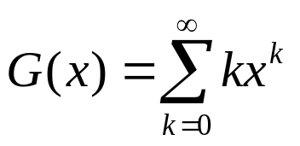
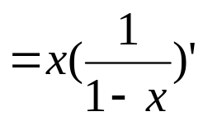
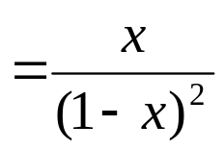
8.4 Generating Functions
Using the above properties, the generating functions of some sequences can be obtained easily.
〖Example 3〗 (1) What is the generating function for the sequence 0,1,2,3,4,5,…?
Solution:

Slide 9
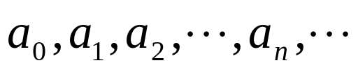
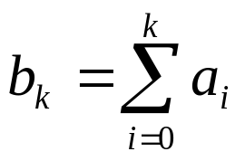

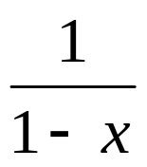
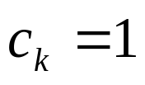

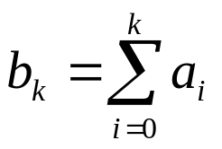
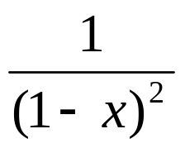
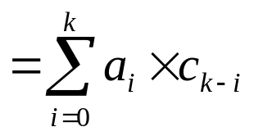

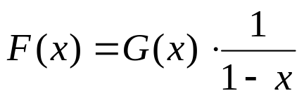
8.4 Generating Functions
〖Example 3〗 (2) Suppose that the generating function of the sequence: is G(x). What is the generating function for the sequence ?
Solution:
For example:

Slide 10
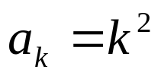
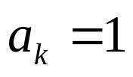
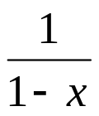
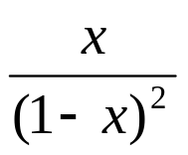
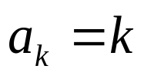
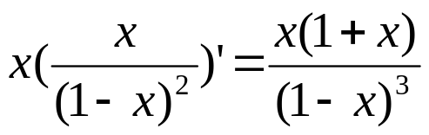
8.4 Generating Functions
〖Example 3〗 (3) What is the generating function for the sequence ?
Solution:

Slide 11
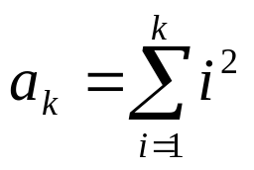
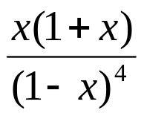
8.4 Generating Functions
〖Example 3〗 (4) What is the generating function for the sequence ?
Solution:

Slide 12
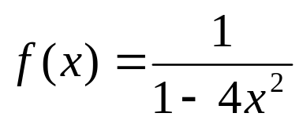
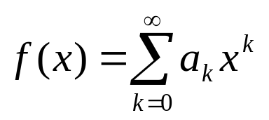
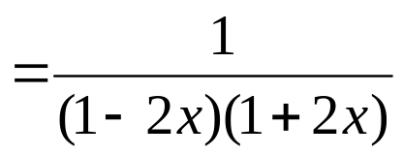
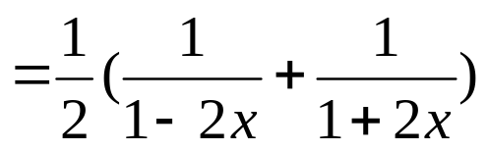

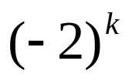
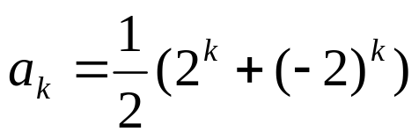
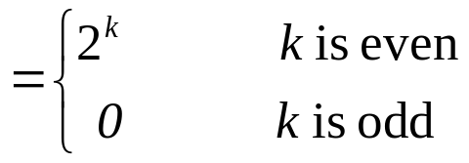
8.4 Generating Functions
〖Example 4〗 Let . Find the coefficient
in the expansion .
Solution:

Slide 13
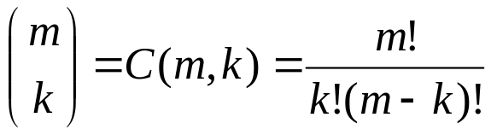
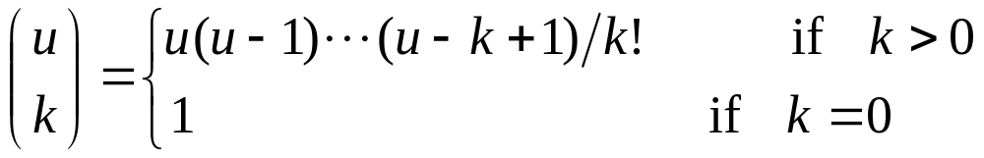
8.4 Generating Functions
The extended binomial coefficient
Recall:
  Where m, k are nonnegative integers, k≤m
【Definition 2】 Let u be a real number and k a nonnegative integer. Then the extended binomial coefficient is defined by

Slide 14
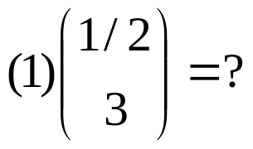
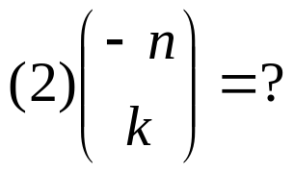
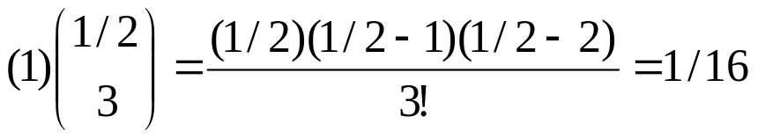
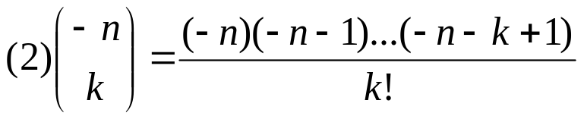


8.4 Generating Functions
〖Example 5〗
Solution:

Slide 15


8.4 Generating Functions
The extended Binomial Theorem
【 Theorem 2】Let x be a real number with and let u be
a real number. Then

Slide 16








8.4 Generating Functions
〖Example 6〗Find the generating functions for
where n is a positive integer, using the extended Binomial Theorem.
Solution:
By the extended Binomial Theorem , it follows that

Slide 17












8.4 Generating Functions
3. Some Common Used Generating Functions
Sequence Generating function

Slide 18










8.4 Generating Functions
3. Some Common Used Generating Functions
Sequence Generating function

Slide 19
8.4 Generating Functions
4. Counting with Generating Functions
Generating functions can be used to solve a wide variety of counting problems, such as
Count the number of combinations from a set when repetition is allowed and additional constraints exist.
Count the number of permutations

Slide 20


8.4 Generating Functions
〖Example 7〗Use generating functions to find the number of r-combinations from a set with n elements with repetitions allowed.
Solution:
Since there are n elements in the set, each can be selected zero times, one times and so on. It follows that
the number of r-combinations from a set with n elements with repetitions allowed, is the coefficient a_{r} of x^{r} in the expansion of G(x) . Since
Then the coefficient a_{r} equals C (n+r-1,r)

Slide 21



8.4 Generating Functions
〖Example 8〗Find the number of solutions of where are nonnegative integers with
.
Solution:
The generating function for this counting problem is
The number of solutions is the coefficient of x¹⁷ in the expansion of
G(x).

Slide 22








8.4 Generating Functions
〖Example 9〗Suppose that there are 2r red balls, 2r blue balls, and 2r white balls. How many ways to select 3r balls from these balls?
Solution:
How to find a_{3r} ?
The coefficient a_{3r} of x^{3r} in the expansion of G(x) is the solution of this problem.
The coefficient of term x^{i} in F(x) is
The coefficient of term x^{r-1} in F(x) is

Slide 23
8.4 Generating Functions
〖Example 10〗Determine the number of ways to insert tokens worth $1,$2 and $5 into a vending machine to pay for an item that costs r dollars in both the cases when the order in which the tokens are inserted does not matter and when the order does matter.

Slide 24


8.4 Generating Functions
Solution:
(1) The order in which the tokens are inserted does not matter
The coefficient of x^{r} in the expansion of G(x) is the solution of this problem.
(2) The order in which the tokens are inserted does matter
The number of ways to insert exactly n tokens to produce a
total of r$ is the coefficient of x^{r} in
Since any number of tokens may be inserted, the number
of ways to produce r$ using $1,$2 and $5 tokens, is the
coefficient of x^{r} in

Slide 25

8.4 Generating Functions
5. Using Generating Functions to Solve Recurrence Relations
The Methods of Solving Recurrence Relations
  Iterative approach
  Use a systematic way to solve an important class of recurrence relations
  Generating functions
Method:
(1) Use the recurrence relation
to find the generating
function of this sequence;
(2)

Slide 26












8.4 Generating Functions
〖Example 11〗 Use generating functions to solve the recurrence relation with initial conditions .
Solution:

Slide 27








7.4 Generating Functions

Slide 28
7.4 Generating Functions
6. Proving Identities via Generating Functions
The method of proving combinatorial identities:
  Use combinatorial proofs
  Use generating functions

Slide 29

7.4 Generating Functions
〖Example 12〗 Use generating functions to prove Pascal’s identity when n and r are positive integers with .

Slide 30






7.4 Generating Functions
Proof:

Slide 31
Homework: (No need to submit)
Ver. 8
Sec. 8.4 6(d,f), 10 (c, d, e), 16, 24(a), 32, 36, 45
Ver. 7
Sec. 8.4 6(d,f), 10 (c, d, e), 16, 24(a), 30, 34, 43

